Slide 1
Selenium Testing And TestNg testing
AQE_FINAL_PROJECT_SUBMISSION

Slide 2
Agenda
INTRODUCTION OF SELENIUM AND TESTNG 3
SIGN UP TESTING 6
LOGIN PAGE TESTING 9
HOME PAGE TESTING 12
SUMMARY 15

Slide 3
Introduction
Selenium is an open_source umbrella project for a range of tools and libraries aimed at supporting browser automation. It provides a playback tool for authoring functional tests across most modern web browsers, without the need to learn a test scripting language (Selenium IDE).
It also provides a test domain-specific language (Selenese) to write tests in a number of popular programming languages,including JavaScript (Node.js), C#, Groovy, Java, Perl, PHP, Python, Ruby and Scala. Selenium runs on Windows, Linux, and macOS.

Slide 4
Introduction
TestNG is a testing framework for Java that is widely used in test automation. It provides a wide range of features for writing and running tests, including annotations, test configuration, data-driven testing, parallel execution, and reporting.
Annotations are a key feature of TestNG, allowing developers to specify the behavior of test methods using simple, descriptive keywords such as @Test, @BeforeMethod, @AfterMethod, @DataProvider, and @Parameters. These annotations enable TestNG to automatically execute tests in a specified order and with a predefined set of data inputs.

Slide 5
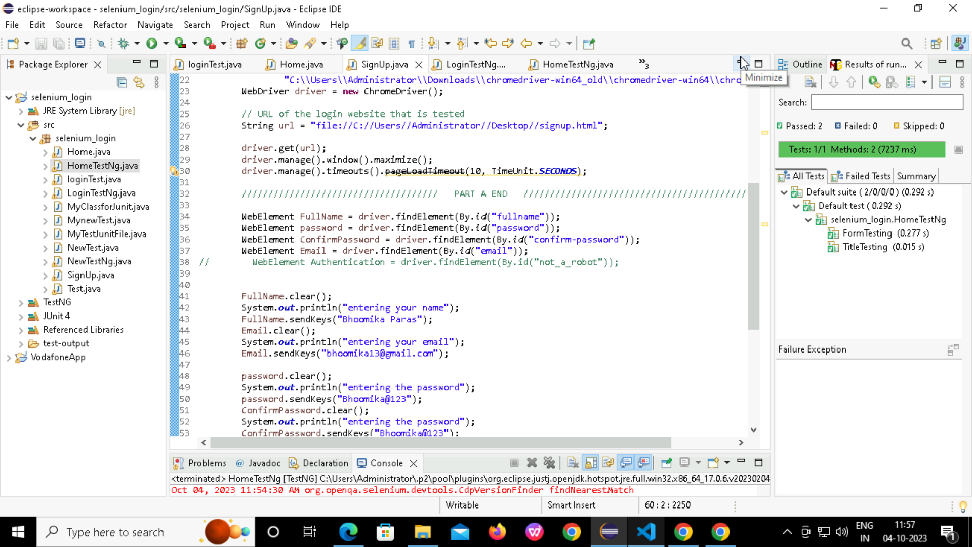
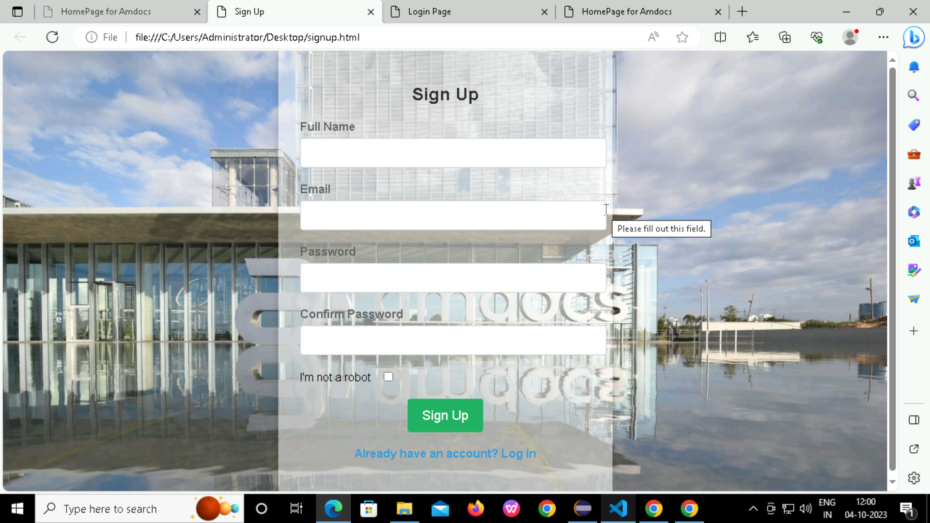
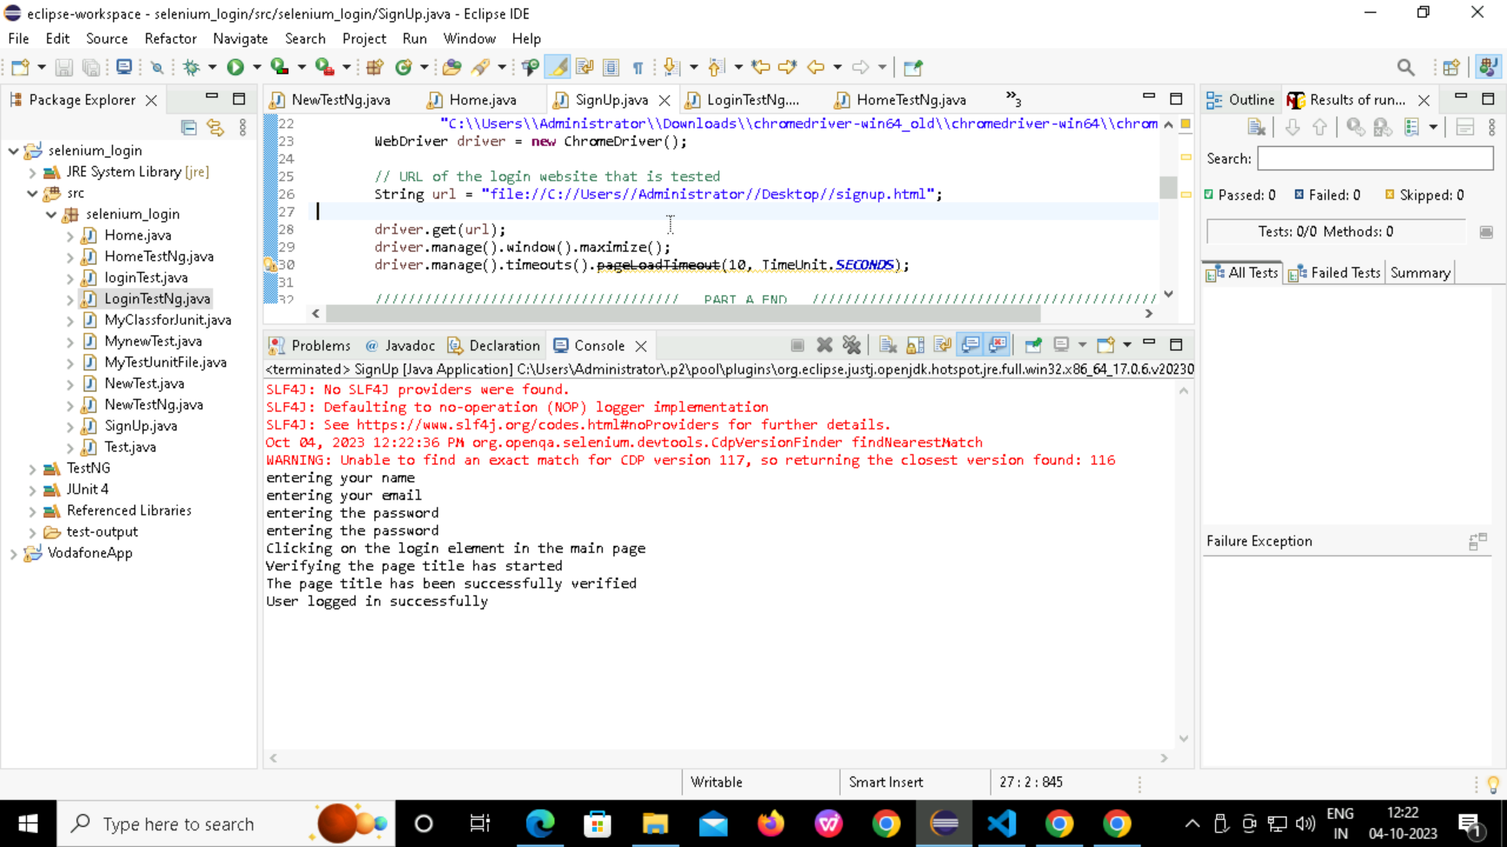
SIGN UP
BY SELENIUM

Slide 6
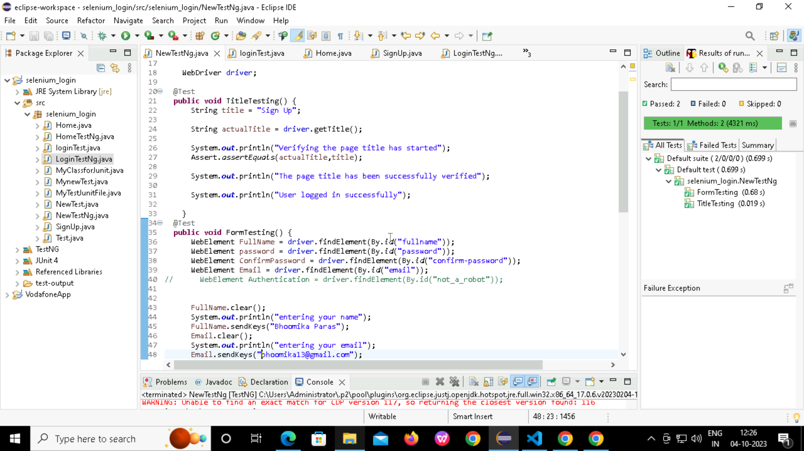
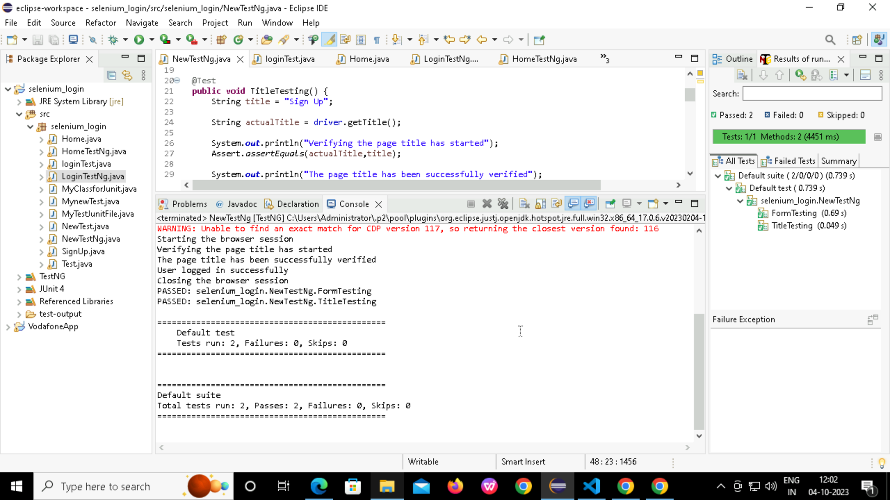
SIGN UP
BY TestNg

Slide 7
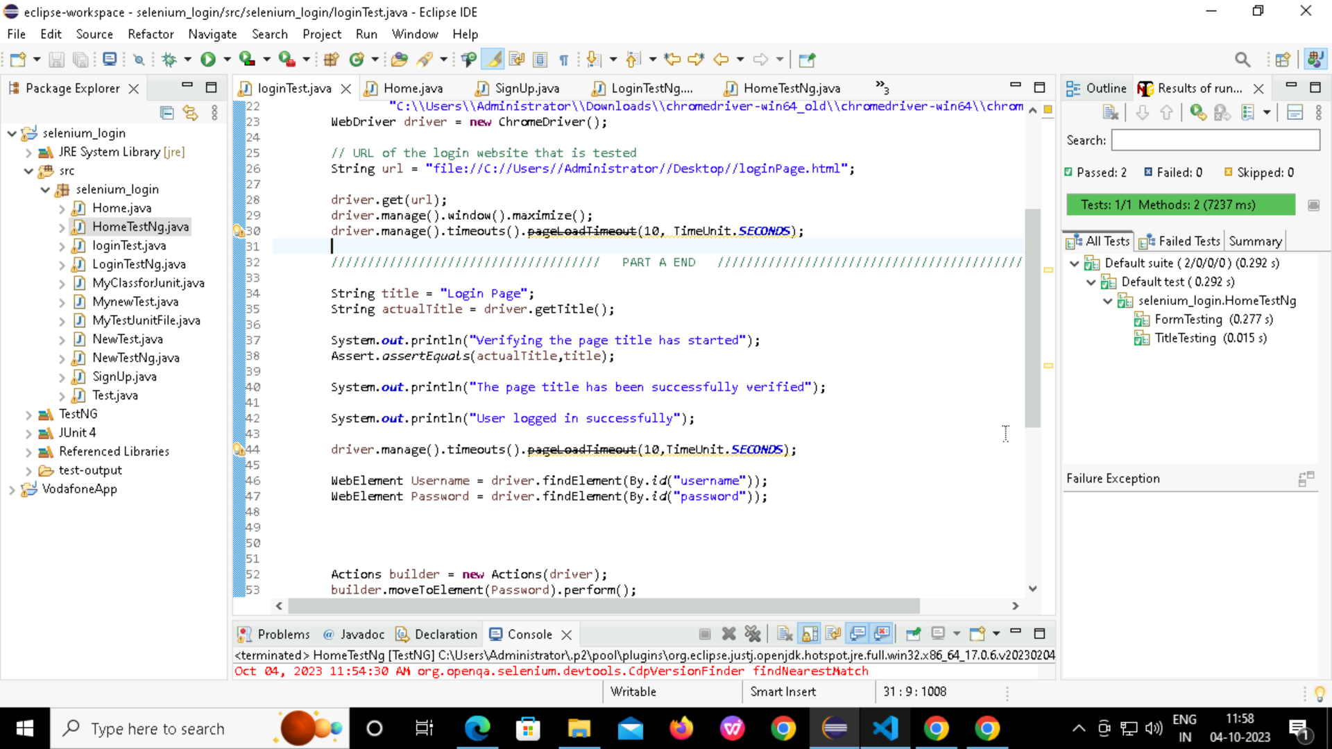

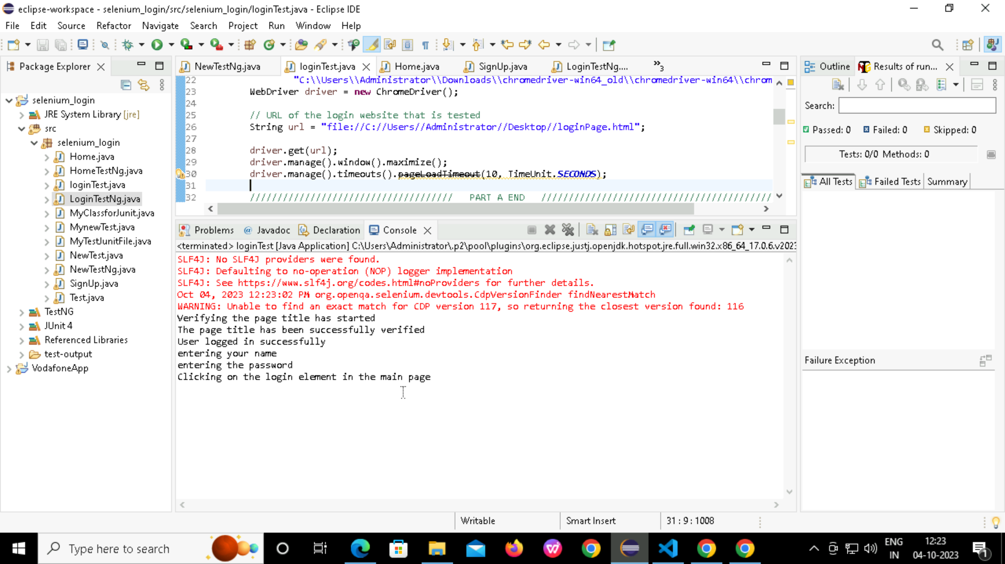
LOGIN
BY SELENIUM

Slide 8
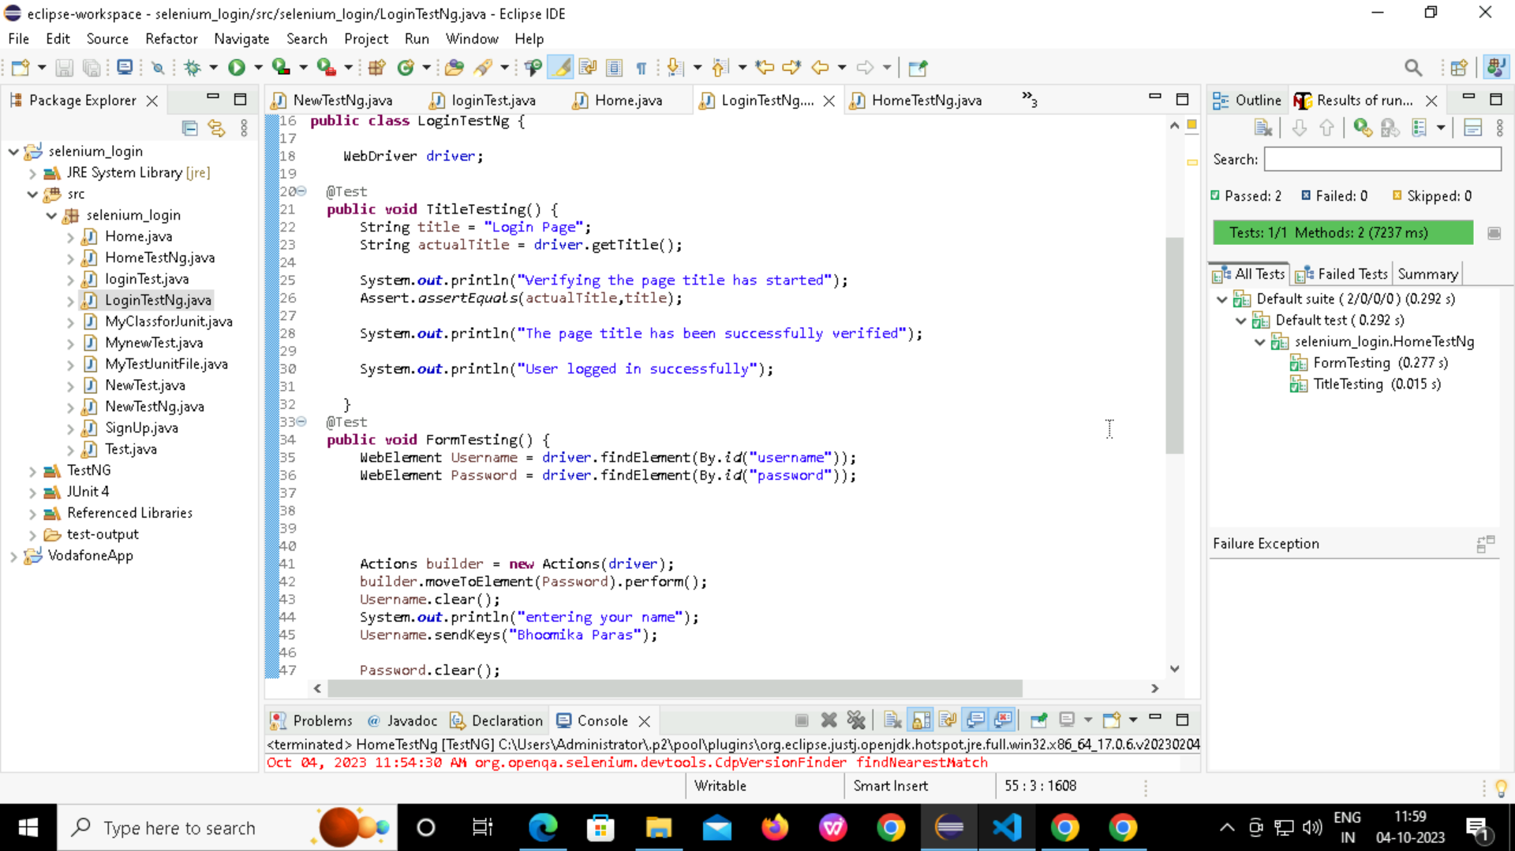

LOGIN
BY TestNg

Slide 9
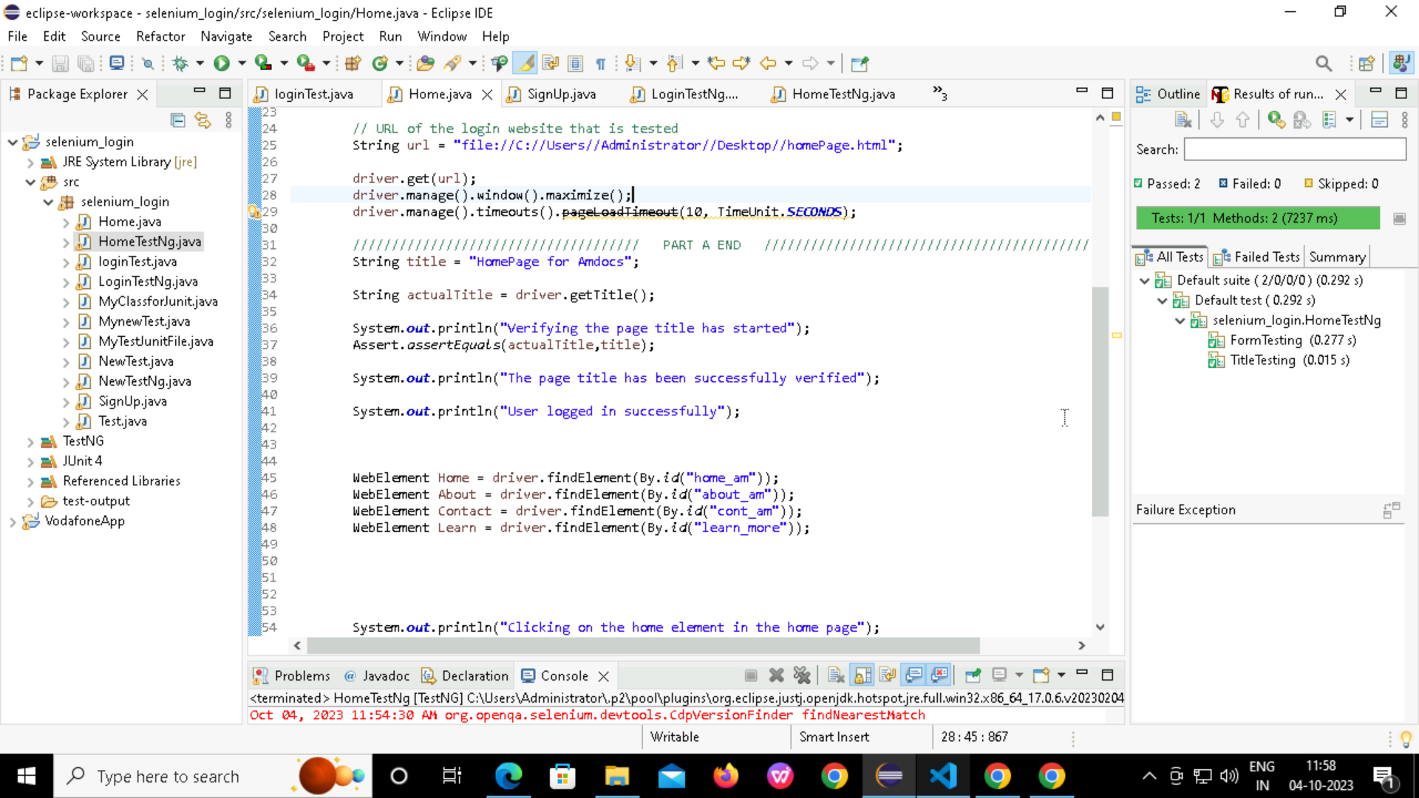

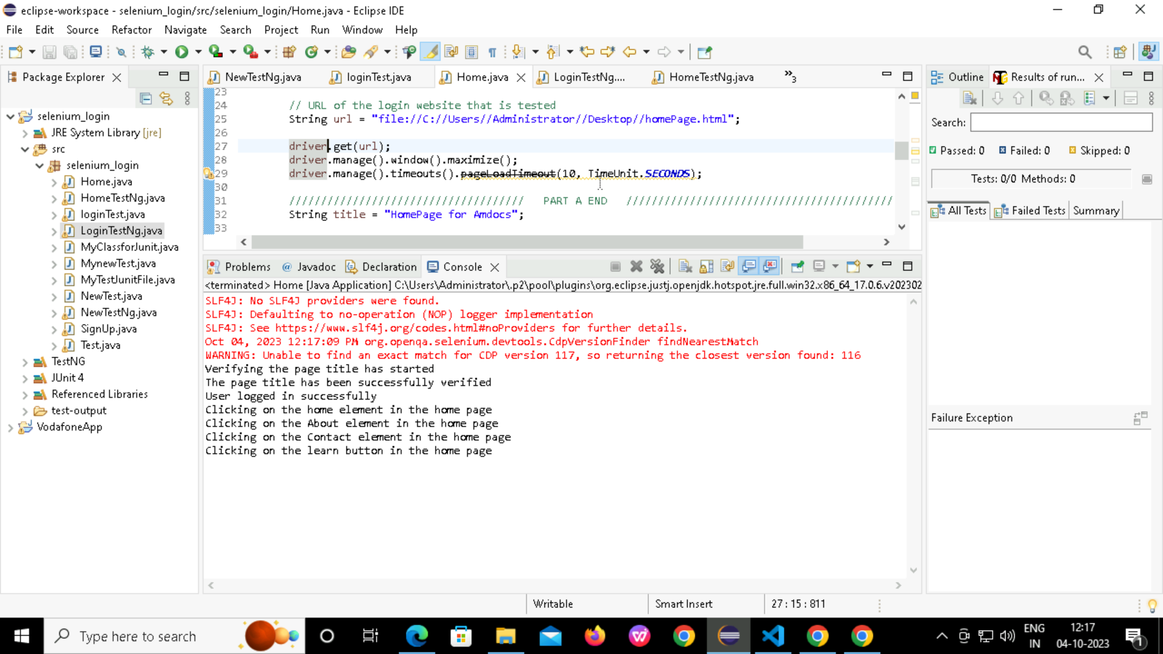
HOME PAGE
BY SELENIUM

Slide 10
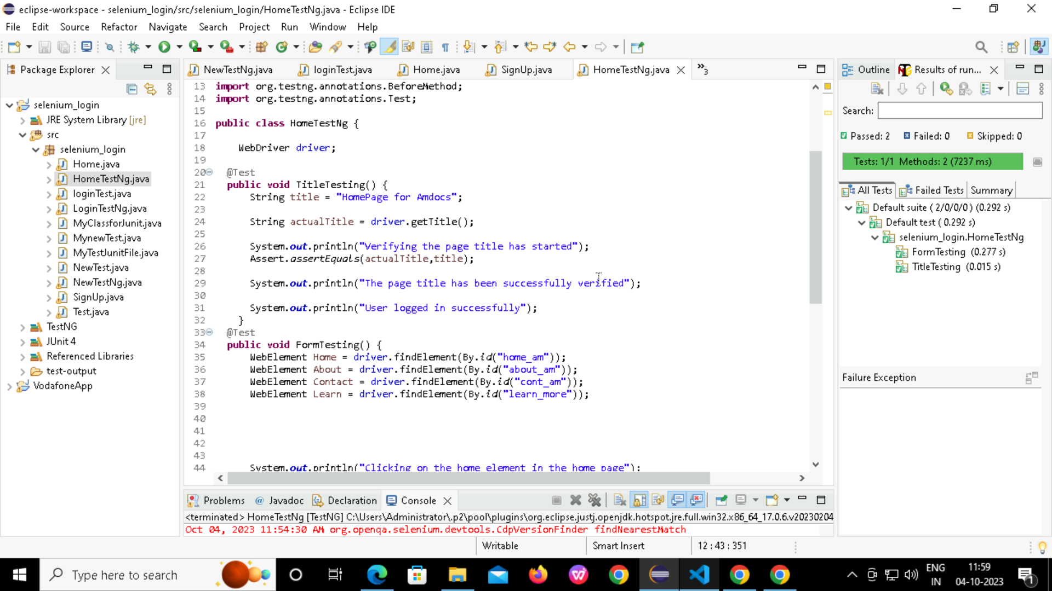
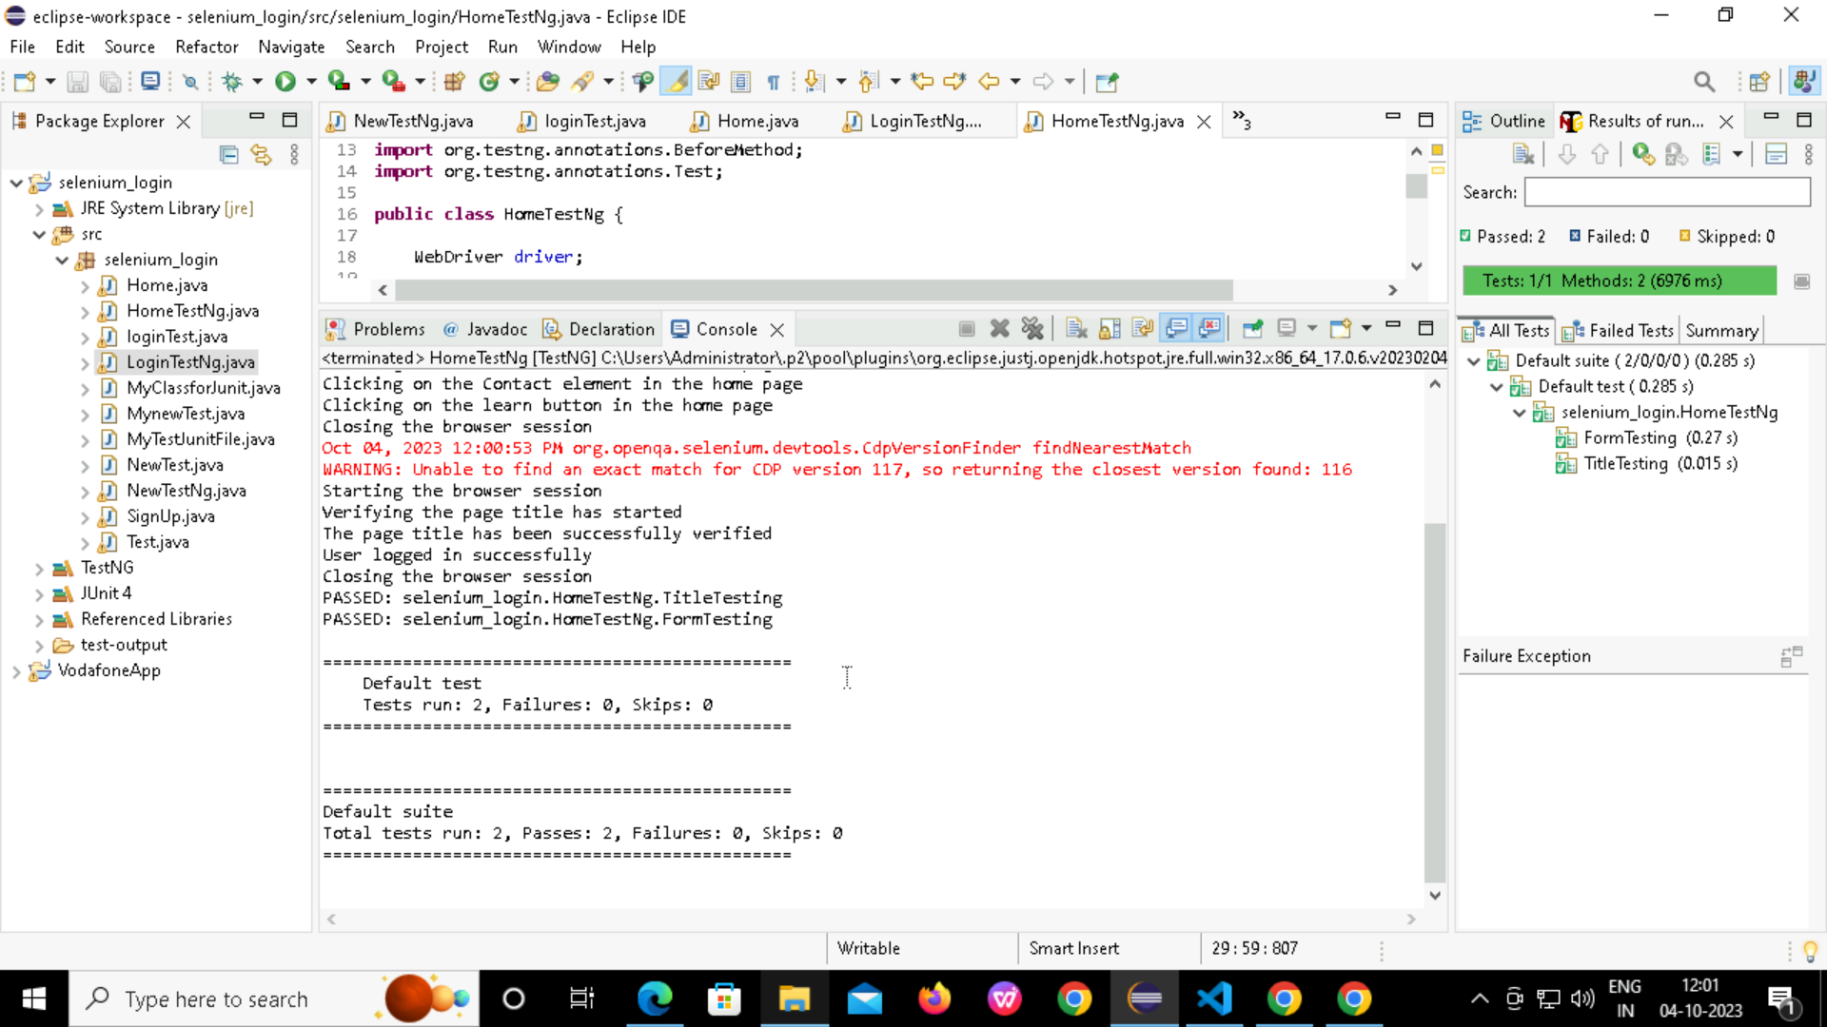
HOME PAGE
BY TestNg

Slide 11
SUMMARY
TestNG is a testing framework that makes Selenium tests easier to understand and generates easy-to-understand reports
By using TestNG in Selenium, you can:
:Generate the report in a proper format.
Include the number of test cases run; tests passed, failed, and skipped in the report.
Group test cases by converting them to testing.xml.
Use invocation count and execute multiple tests without using loops.
Perform cross-browser testing.
​

Slide 12
THANKYOU

